Slide 3
Announcements
HW: Due Tuesday Oct 27th.
Start looking at an article to do your write-up on.
Best article is from Nature, Science, Cell.
(though can choose from any scientific journal)
Want an article that has a significant impact on field.
Thursday, Oct 29th, turn in the article, a secondary article that is a review of the field at which your article is about.
Turn in a paragraph, summarizing it.
The article’s general point, and why you’ve chosen it.
(why it’s important, interesting,
Send your write-up and PDF of article to me by email.
(It won’t be graded but will make sure it’s appropriate.)

Slide 4
Optical Tweezers is an ultrasensitive technique
Able to see an individual molecule at a time
--like magnetic trap, atomic force microscopy
--unlike x-rays diffraction
Single Molecules: Don’t need to have to synchronize a population to study kinetics. For example: a molecular motor which uses ATP.

Slide 5
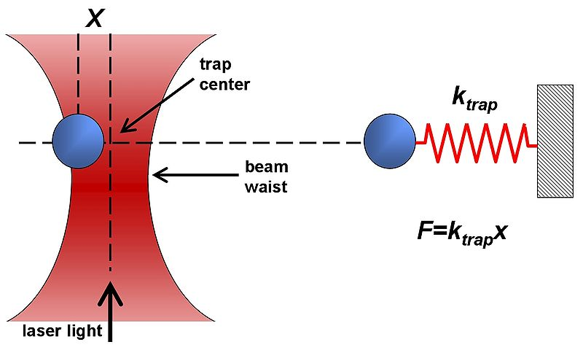
Optical Traps (Tweezers) con’t
Dielectric objects are attracted to the center of the beam, slightly above the beam waist (when laser comes from bottom). This depends on the difference of index of refraction between the bead and the solvent (water).
Vary k_{trap} with laser intensity such that k_{trap} ≈ k_{bio} (k ≈ 0.1pN/nm)
Can measure pN forces and (sub-) nm steps!
http://en.wikipedia.org/wiki/Optical_tweezers

Slide 6
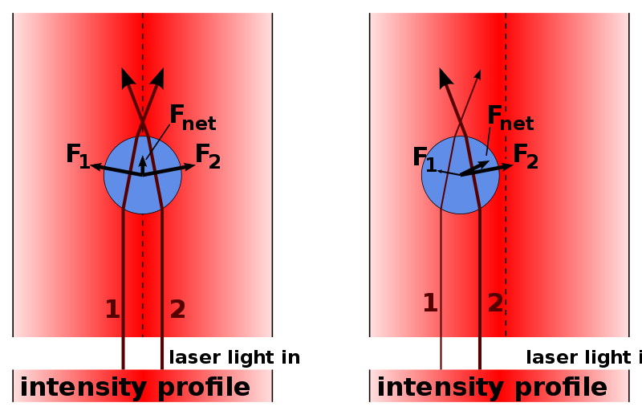
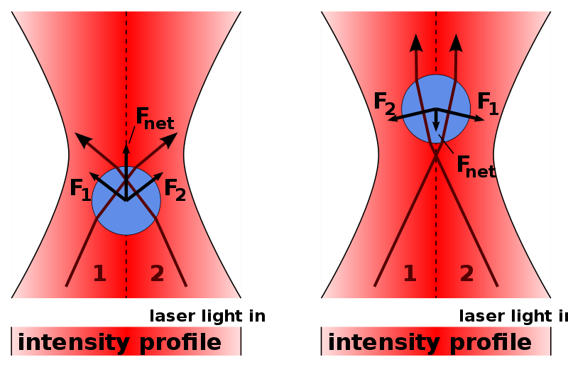
Why does index of refraction of bead
n_{bead} > n_{water} for trap to work?
n_{bead} = n_{water}
Beam doesn’t change at all
No scattering, no bending
Regular, stable trap.
Force towards most intense light.
Scattering, Bending.
n_{bead} > n_{water}
n_{bead} < n_{water}
Unstable trap.
Force towards least intense light.
Scattering, Bending, wrong way.

Slide 7
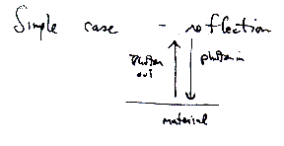
Estimate size of trapping force
Want: Force (pN) as a function of Laser Power (mW)
F= Δp/Δt =
2 p_{photon}/Δt
≈ Qp_{photon}/Δt
Convert p_{photon} into Energy/time = Power
Photon in vacuum: Energy = f( p_{photon} )
Photon in index of refraction n: goes with speed v
= p_{photon}c
E = p_{photon}v = p_{photon}c/n
E/Δt = p_{photon}c/nΔt = Power = P
p_{photon}/Δt = Power n/c
Incident momentum/sec =
Power P in medium of refractive index.
F = Qp_{photon}/Δt =
QPn/c

Slide 8
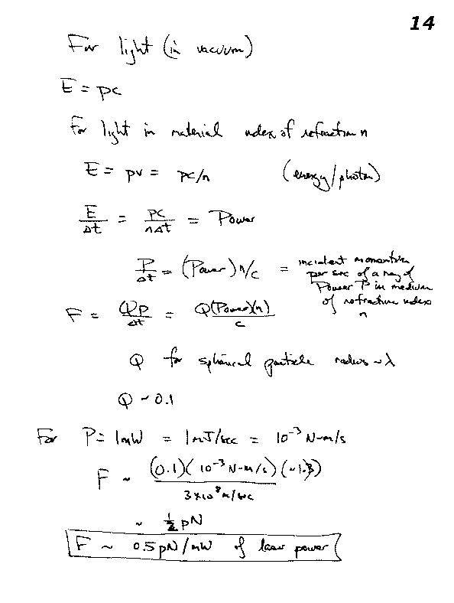
Estimating Trap Force/Stiffness
F = QPn/c
Q spherical particle radius ~ λ ~ 0.1
This is approximately correct:
Vary k_{trap} with laser intensity such that k_{trap} ≈ k_{bio} (k ≈ 0.1pN/nm)

Slide 9
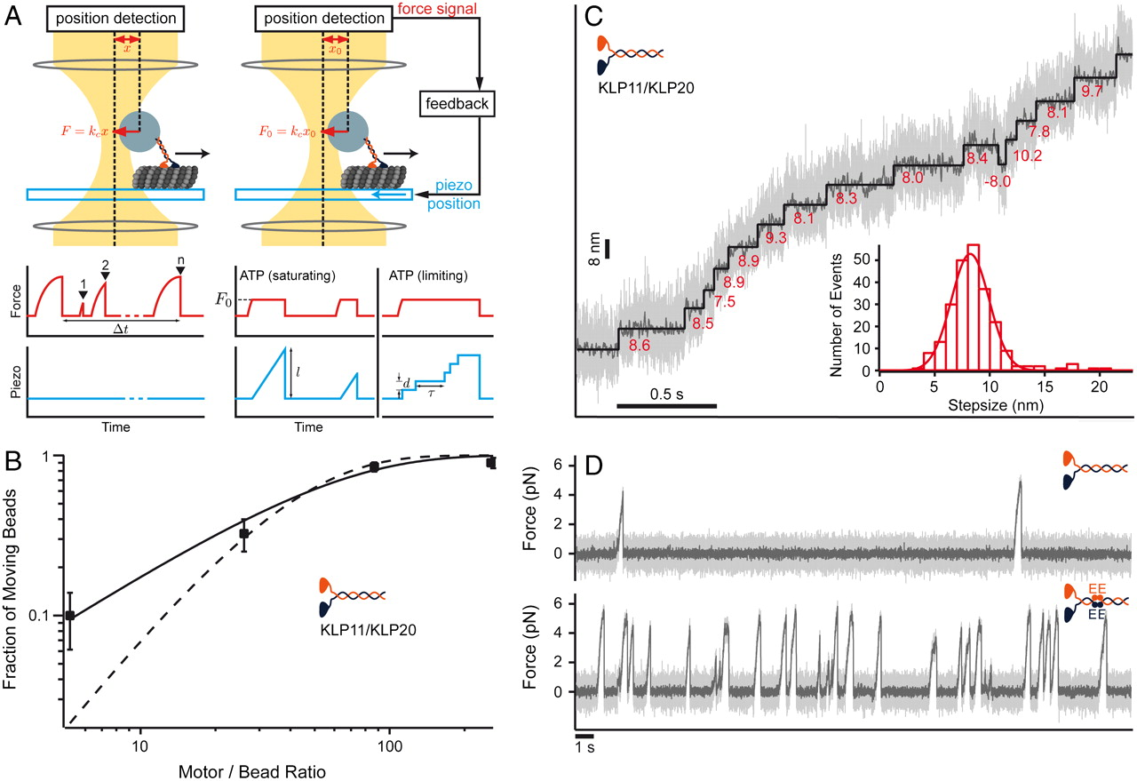
Regular vs. Force-feedback
(Left) Stationary trapping of a polystyrene bead (blue) that is decorated with motor proteins in a focused laser beam (yellow). The optical trap exerts a force on the bead that can be approximated by Hooke’s Law (F = k_{c}x), where k_{c} is the spring constant of the laser trap and x is the displacement of the bead. The red curve illustrates “walking events” displayed by a single motor attached to a trapped bead. The number of such “walks” per time frame defines the SMWF of a motor and thus a measure for its motor activity. (Right) Force feed-backed trapping mode. The restoring force acting on the motor is clamped to a constant value F0 by moving the piezo stage in the opposite direction to the motor’s movement. Contrary to the stationary modus, the piezo signal (light blue) gives information about the run length (l) of a motor and allows resolving discrete steps (step size d, dwell time τ) at limiting ATP concentrations.
Brunnbauer M et al. PNAS 2010;107:10460-10465
©2010 by National Academy of Sciences
Notes:
The KLP11/KLP20 heterodimer is an autoinhibited and processive molecular motor. (A) Schematics of the experimental setup. (Left) Stationary trapping of a polystyrene bead (blue) that is decorated with motor proteins in a focused laser beam (yellow). The optical trap exerts a force on the bead that can be approximated by Hooke’s Law (F = kcx), where kc is the spring constant of the laser trap and x is the displacement of the bead. The red curve illustrates “walking events” displayed by a single motor attached to a trapped bead. The number of such “walks” per time frame defines the SMWF of a motor and thus a measure for its motor activity. (Right) Force feed-backed trapping mode. The restoring force acting on the motor is clamped to a constant value F0 by moving the piezo stage in the opposite direction to the motor’s movement. Contrary to the stationary modus, the piezo signal (light blue) gives information about the run length (l) of a motor and allows resolving discrete steps (step size d, dwell time τ) at limiting ATP concentrations. (B) A single KLP11/KLP20 molecule can support bead movement. The fraction of moving beads at saturating ATP concentrations (2 mM) is plotted against the calculated number of KLP11/KLP20 molecules per bead and fit to models that require only one [solid line: f(x) = 1 - exp(-λ ∗ x)] or minimally two motors to move a bead [dashed line: f(x) = 1 - exp(-λ ∗ x) - λ ∗ x ∗ exp(-λ ∗ x)]. (C) Resolving individual steps of a single KLP11/KLP20 molecule at subsaturating ATP (5 μM) under constant backward load (1.4 pN). Raw data: light gray, box-filtered data: dark gray. An automated step finder identified the step sizes (red numbers) of individual steps of a single KLP11/KLP20 molecule (black line). (Inset) histogram of step sizes. The Gaussian fit reveals a step size of (8.23 ± 0.16) nm (mean ± SEM) (N = 239). (D) Mutations in the tail domain of KLP11/KLP20 increase the frequency with which a single motor initiates a processive run.

Slide 10
Ensuring a single molecular motor
(B) A single KLP11/KLP20 (kinesin) molecule can support bead movement. The fraction of moving beads at saturating ATP concentrations (2 mM) is plotted against the calculated number of KLP11/KLP20 molecules per bead and fit to models that require only one [solid line: f(x) = 1 - exp(-λ ∗ x)] or minimally two motors to move a bead [dashed line: f(x) = 1 - exp(-λ ∗ x) - λ ∗ x ∗ exp(-λ ∗ x)].
Brunnbauer M et al. PNAS 2010;107:10460-10465
Do for homework!
©2010 by National Academy of Sciences
Notes:
The KLP11/KLP20 heterodimer is an autoinhibited and processive molecular motor. (A) Schematics of the experimental setup. (Left) Stationary trapping of a polystyrene bead (blue) that is decorated with motor proteins in a focused laser beam (yellow). The optical trap exerts a force on the bead that can be approximated by Hooke’s Law (F = kcx), where kc is the spring constant of the laser trap and x is the displacement of the bead. The red curve illustrates “walking events” displayed by a single motor attached to a trapped bead. The number of such “walks” per time frame defines the SMWF of a motor and thus a measure for its motor activity. (Right) Force feed-backed trapping mode. The restoring force acting on the motor is clamped to a constant value F0 by moving the piezo stage in the opposite direction to the motor’s movement. Contrary to the stationary modus, the piezo signal (light blue) gives information about the run length (l) of a motor and allows resolving discrete steps (step size d, dwell time τ) at limiting ATP concentrations. (B) A single KLP11/KLP20 molecule can support bead movement. The fraction of moving beads at saturating ATP concentrations (2 mM) is plotted against the calculated number of KLP11/KLP20 molecules per bead and fit to models that require only one [solid line: f(x) = 1 - exp(-λ ∗ x)] or minimally two motors to move a bead [dashed line: f(x) = 1 - exp(-λ ∗ x) - λ ∗ x ∗ exp(-λ ∗ x)]. (C) Resolving individual steps of a single KLP11/KLP20 molecule at subsaturating ATP (5 μM) under constant backward load (1.4 pN). Raw data: light gray, box-filtered data: dark gray. An automated step finder identified the step sizes (red numbers) of individual steps of a single KLP11/KLP20 molecule (black line). (Inset) histogram of step sizes. The Gaussian fit reveals a step size of (8.23 ± 0.16) nm (mean ± SEM) (N = 239). (D) Mutations in the tail domain of KLP11/KLP20 increase the frequency with which a single motor initiates a processive run.

Slide 11
Seeing a single molecular motor
Kinesin walks with 8 nm step!
©2010 by National Academy of Sciences
Notes:
The KLP11/KLP20 heterodimer is an autoinhibited and processive molecular motor. (A) Schematics of the experimental setup. (Left) Stationary trapping of a polystyrene bead (blue) that is decorated with motor proteins in a focused laser beam (yellow). The optical trap exerts a force on the bead that can be approximated by Hooke’s Law (F = kcx), where kc is the spring constant of the laser trap and x is the displacement of the bead. The red curve illustrates “walking events” displayed by a single motor attached to a trapped bead. The number of such “walks” per time frame defines the SMWF of a motor and thus a measure for its motor activity. (Right) Force feed-backed trapping mode. The restoring force acting on the motor is clamped to a constant value F0 by moving the piezo stage in the opposite direction to the motor’s movement. Contrary to the stationary modus, the piezo signal (light blue) gives information about the run length (l) of a motor and allows resolving discrete steps (step size d, dwell time τ) at limiting ATP concentrations. (B) A single KLP11/KLP20 molecule can support bead movement. The fraction of moving beads at saturating ATP concentrations (2 mM) is plotted against the calculated number of KLP11/KLP20 molecules per bead and fit to models that require only one [solid line: f(x) = 1 - exp(-λ ∗ x)] or minimally two motors to move a bead [dashed line: f(x) = 1 - exp(-λ ∗ x) - λ ∗ x ∗ exp(-λ ∗ x)]. (C) Resolving individual steps of a single KLP11/KLP20 molecule at subsaturating ATP (5 μM) under constant backward load (1.4 pN). Raw data: light gray, box-filtered data: dark gray. An automated step finder identified the step sizes (red numbers) of individual steps of a single KLP11/KLP20 molecule (black line). (Inset) histogram of step sizes. The Gaussian fit reveals a step size of (8.23 ± 0.16) nm (mean ± SEM) (N = 239). (D) Mutations in the tail domain of KLP11/KLP20 increase the frequency with which a single motor initiates a processive run.

Slide 12
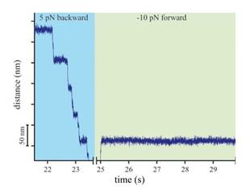
Can Study mutations, directionality…
Can study mutations.
(Mutations in tail domain increase frequency of processive runs.)
Brunnbauer M et al. PNAS 2010;107:10460-10465
Myosin V under large backward (induce processive motion) and forward loads (cannot induce ATP-independent forward steps.
http://bio.ph.tum.de/home/e22-prof-dr-rief/research/molecular-motors.html
©2010 by National Academy of Sciences
Notes:
(D) Mutations in the tail domain of KLP11/KLP20 increase the frequency with which a single motor initiates a processive run.
Myosin-V
The forward motion of many molecular motors has already been extensively studied. In our experiments we investigated the motion of Myosin-V under both high backward and forward loads. We find a pronounced asymmetry in the response of Myosin-V to high backward and forward forces. High backward loads can induce processive backward stepping independent of ATP hydrolysis. In contrast forward forces can not induce ATP-independent forward steps. [3]

Slide 13
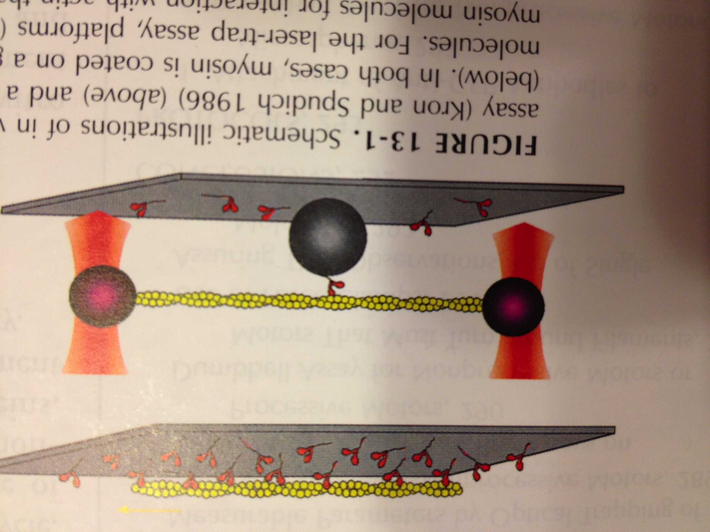
Can study non-processive motors
With processive motors, multiple steps are no problem.
With non-processive motors, multiple steps are a problem.
JA Spudich, Single Molecule Techniques
Nail down non-processive motors so when releases,
motor doesn’t float away, e.g. Myosin II (95% of time free).

Slide 14
What is noise in measurement?.
The noise in position using equipartition theorem
[For a typical value of stiffness (k) = 0.1 pN/nm.]
<x²>^{1/2} = (k_{B}T/k)^{1/2} = (4.14/0.1)^{1/2} = (41.4)^{1/2} ~ 6.4 nm
6.4 nm is a pretty large number.
[ Kinesin moves every 8.3 nm; 1 base-pair = 3.4 Å ]
How to decrease noise?
Hint: Equipartion Theorem calculates for noise at all frequencies (infinite bandwidth).
Reduce bandwidth. (Get to soon!)
Also: Operate at high force→ less noise due to finite Temp.
Also be clever about how to differentiate noise from signal.
Notes:
If you look at the expression for the power spectrum, amplitude at low frequency (basically the part which is flat in frequency) is 4*kT*gamma/k^2. (The alpha term is if you measure the power spectrum in V (volts): assume everything is converted into position (in nm), then you don’t need the alpha^2.)
To get the position noise, you need to integrate the power spectrum over frequency. If the bandwidth BW is smaller than the corner frequency, then it’s a simple integration, because the power spectrum is constant, with amplitude 4*kT*gamma/k^2.
So, the noise over bandwidth BW is 4*kT*gamma*BW/k^2.
To get the rms noise in the bandwidth, you take the square root: sqrt(4*kT*gamma*BW)/k
For a BW = 100 Hz, gamma = 1e-6, stiffness k = 0.1 you have: sqrt(4*4.14*1e6*100)/0.1
(all in units of pN, nm)

Slide 15
Class evaluation
What was the most interesting thing you learned in class today?
2. What are you confused about?
3. Related to today’s subject, what would you like to know more about?
4. Any helpful comments.
Answer, and turn in at the end of class.

